Slide 1
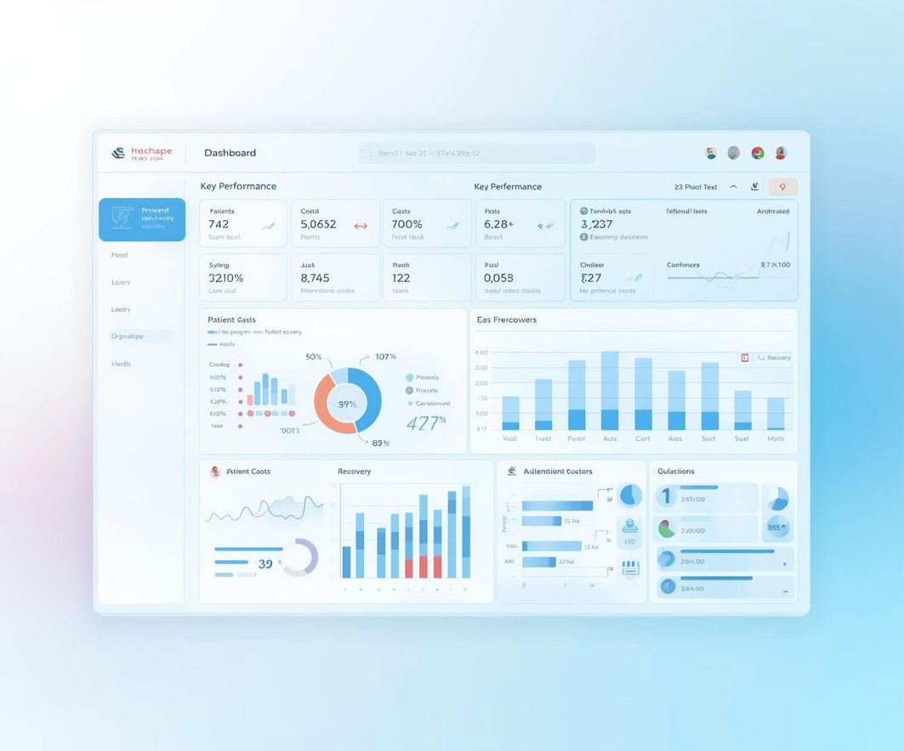
Hospital Insight Dashboard
Shivam Kumar Thakur
BUSINESS ANALYST

Slide 2

Executive Overview
High-Level Summary of Dashboard Scope and Insights
The Hospital Insight Dashboard encompasses data from 1,000 patients, offering an extensive analysis of costs, demographics, diagnoses, treatments, and recovery outcomes. The key takeaway highlights moderate recovery rates (Avg. 5.44) and the potential for optimization through cost variation analysis. This presents an opportunity for enhancing healthcare delivery.

Slide 3
$9.44M
Total Cost to Hospital
5.44
Average Recovery Rating
50.5 years
Average Patient Age

Slide 4

Patient Demographics
Age Group Breakdown for Better Care Strategies
Understanding patient demographics is crucial for effective healthcare delivery. The age distribution reveals that 88% of our patients are adults and seniors, indicating a strong need for chronic disease management and tailored care strategies. This insight helps prioritize resources and improve outcomes for these populations.

Slide 5
Diagnosis Performance
Comparing Volume and Recovery Ratings
Volume Highlights
Recovery Ratings
The highest volume diagnoses include Diabetes, Asthma, and Covid-19, with respective counts of approximately 208, 203, and 202. These figures indicate prevalent health issues within the patient population, underscoring the need for targeted resources and strategies to address the management and treatment of these conditions effectively.
Recovery ratings reveal significant disparities among diagnoses, with Hypertension leading at 5.75 and Asthma trailing at 5.11. This difference highlights a critical area for intervention, suggesting that additional support and improved treatment protocols for Asthma patients could enhance recovery outcomes and overall patient satisfaction in the healthcare system.

Slide 6
Cost vs Recovery
Analyzing Key Diagnoses and Outcomes
Cost Insights
Recovery Challenges
Understanding the relationship between cost and recovery is essential. Notably, Hypertension presents the highest cost at approximately $10.62K, yet it achieves the best recovery rating at 5.75. This suggests that effective management strategies are in place, and the focus should be on replicating these practices across other diagnoses to optimize outcomes and resource allocation.
Asthma, despite moderate costs of around $10.00K, shows the lowest recovery rating at 5.11. This underperformance indicates a critical need for process improvements and standardized care pathways. Addressing the inefficiencies in asthma treatment could significantly enhance recovery rates, ensuring that resources are directed toward effective interventions and improving patient outcomes.

Slide 7

Treatment Mix
Analyzing Patient Distribution Across Treatment Types and Age Groups
Understanding the treatment mix among different age groups is essential for optimizing healthcare services. Our data reveals balanced distributions across medication, therapy, and surgery. Notably, seniors exhibit higher surgery rates, indicating a need for specialized staffing and resource allocation to better meet their healthcare demands.

Slide 8

Patient Volume Trends
Analyzing monthly patient counts reveals key operational insights
Monthly patient counts exhibit a significant peak of nearly 93 patients, followed by a drop to approximately 60 by year-end. This trend suggests potential seasonality, reporting gaps, or operational constraints that may affect patient volume. Understanding these patterns is crucial for optimizing staffing and resource allocation strategies.

Slide 9





Key Insights from the Dashboard
Asthma Recovery
Covid-19 Costs
Hypertension Protocols
Chronic Care Focus
Volume Decline
Process improvement needed for better outcomes
Resource utilization review is essential
Replicate best practices for success
Emphasis on prevention of age-related issues
Investigate data or demand issues

Slide 10

Recommendations
Actionable Steps for Improving Clinical and Operational Outcomes
To enhance hospital performance, a focus on clinical pathways for asthma and Covid-19 is essential. Standardizing care processes will improve outcomes, while analyzing cost drivers can help allocate resources efficiently. Improving data quality will also ensure better decision-making and operational effectiveness across the board, ultimately leading to enhanced patient care.

Slide 11

Summary of Insights
Key findings and opportunities to enhance hospital performance and efficiency
The dashboard reveals a moderately positive hospital performance overall, yet significant disparities exist across various diagnoses. There are clear opportunities to optimize care, particularly for asthma and Covid-19 patients. Leveraging effective hypertension practices and focusing on chronic care can enhance patient outcomes while maintaining cost efficiency.

Slide 12
Thank You
We appreciate your attention and engagement today

